Slide 1
VoiceFilter-Lite: Streaming Targeted Voice Separation for On-Device Speech Recognition
Authors: Quan Wang, Ignacio Lopez Moreno, Mert Saglam, Kevin Wilson, Alan Chiao,
Renjie Liu, Yanzhang He, Wei Li, Jason Pelecanos, Marily Nika, Alexander Gruenstein
Presented by: Quan Wang <quanw@google.com>
Notes:
Paper: https://arxiv.org/abs/1710.10467

Slide 2
Key messages
What:
A single-channel source separation model for a target speaker
Part of on-device streaming ASR
Why:
Improve ASR on overlapped speech drastically
How:
Filterbanks as inputs and outputs
Asymmetric loss and adaptive runtime suppression strength
Quantize to 8-bit integer model

Slide 3
Part 1:
Recap of VoiceFilter

Slide 4
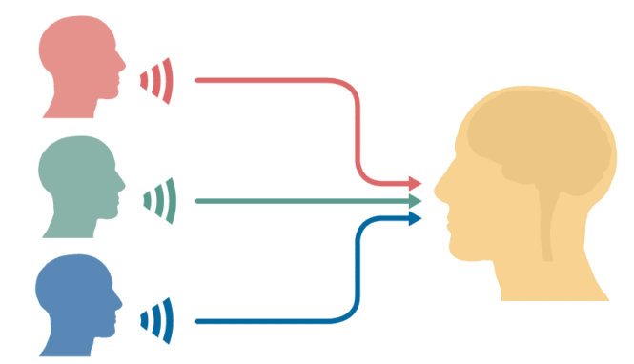
The Cocktail Party Problem
The problem:
Multiple talkers speaking simultaneously
You just want to listen to one person
Conventional solutions:
Multi-channel blind separation
Single-channel blind separation
Image from elixirofknowledge.com
Image from Nima Mesgarani, Columbia University
Notes:
The problem we are solving is known as the cocktail party problem.
When multiple talkers are speaking, and you only want to listen to one person, that's easy for human but difficult for machines.
If there are multiple channels, like human has two ears, multi-channel blind separation algorithms can be used.
But many devices like mobile phones only have one microphone, then single-channel blind separation algorithms can be used.

Slide 5
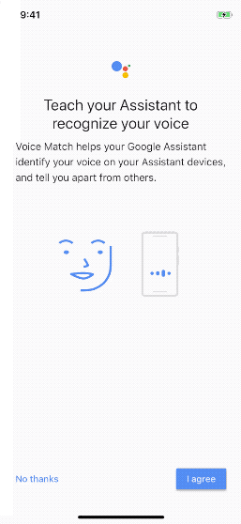
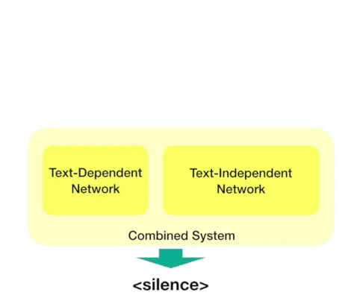
Knowing “whom to listen to”
Voice Match already deployed to:
Android smart phones
Smart home speakers
User’s voice profile stored on device
Blindness sucks
Number of sources is unknown
Single: don’t want to mess up
Multiple: only keep target voice
Multiple outputs, still don’t know which one to use (e.g. to run ASR)
Pick loudest?
Run speaker verification on all?
Permutation invariance: computational cost is high!
Notes:
For example, if you have an Android Phone or Google Home device, you can enable VoiceMatch, which will store a voice profile on the device.
With this voice profile, we are no longer blind.
Here I will explain why blindness sucks.
First, in blind separation, you don't know how many sources are there in the runtime. You may be doing great when the input has multiple sources, but you also don't want to mess up when the input is already single source.
Second, blind separation usually has multiple outputs, you still need to pick the one you need, for example to run ASR.
You can simply pick the loudest one from the outputs, or use an additional speaker verification step, but it's not a trivial task itself.
Finally, permutation invariant training is usually very expensive.

Slide 6
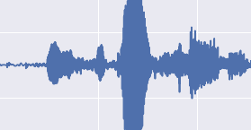
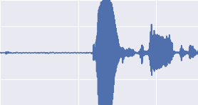
VoiceFilter: Say Goodbye to blindness!
Condition the voice separation task by target speaker embedding
Target speaker embedding
VoiceFilter
Blind separation
Noisy multi-speaker audio
Clean audio of target speaker
Notes:
So, with the proposed VoiceFilter system, we can say Goodbye to blindness.
We make use of the speaker embedding, which can be acquired during user enrollment. This speaker embedding will condition the separation system to output the clean signals from the target speaker.

Slide 7
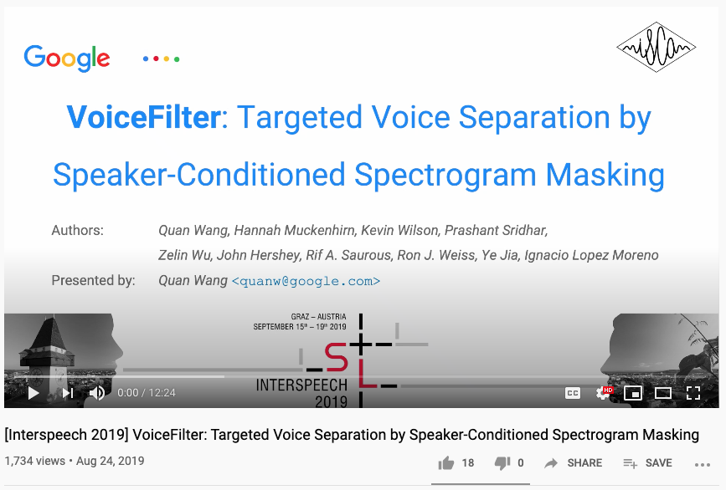
Learn more about VoiceFilter
https://www.youtube.com/watch?v=gnRX2lzepz0

Slide 8
Part 2:
VoiceFilter for on-device ASR

Slide 9
On-device ASR
Moving ASR from cloud to device is the trend
No requirement for Internet
Much less latency due to communications
Better privacy preservation
Example use cases (smartphones, smart home devices):
“Turn on flashlight”
“Turn on bedroom lights”

Slide 10
Challenges: On-device VoiceFilter
Memory and storage:
Model should be really tiny (few MB, not GB)
CPU and battery:
Less runtime operations
Latency:
Model should work in a streaming fashion
ASR should never wait for VoiceFilter

Slide 11
Challenges: VoiceFilter for ASR
Quality:
VoiceFilter: You either always run it, or never run it
Being
always harmless
is more important than being
sometimes helpful!
Clean single speaker
Non-speech noise
Reverberant rooms
Different SNR

Slide 12
Part 3:
The journey to Lite

Slide 13
Optimizing for CPU and latency
Time-frequency CNN
Temporal CNN: Not causal
Convolutions: Computationally expensive
Receptive field can’t see the future
freq
time
CNN layer

Slide 14
Optimizing for CPU and latency
Bi-directional LSTM
Backward pass: Not causal
LSTM layer
We can't use backward LSTM
time
LSTM layer

Slide 15
Optimizing for CPU and latency
STFT
spectrogram
If we only care about ASR:
ASR inputs directly as VoiceFilter inputs & outputs
No need to convert back to waveform
No cool audio demos
VoiceFilter
system
Neural Network
d-vector
spectrogram
iSTFT
Redundant
STFT
spectrogram
filterbanks
Speech Recognition

Slide 16
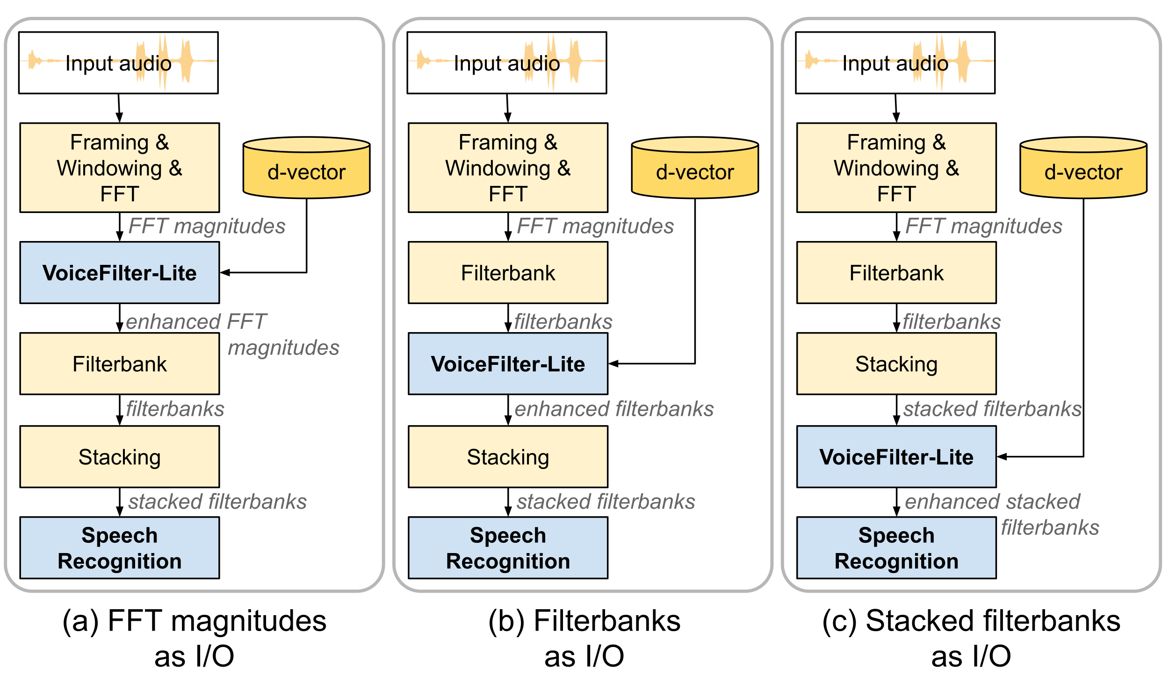
Let’s simplify the feature frontend
ASR uses stacked log Mel-filterbanks as input

Slide 17
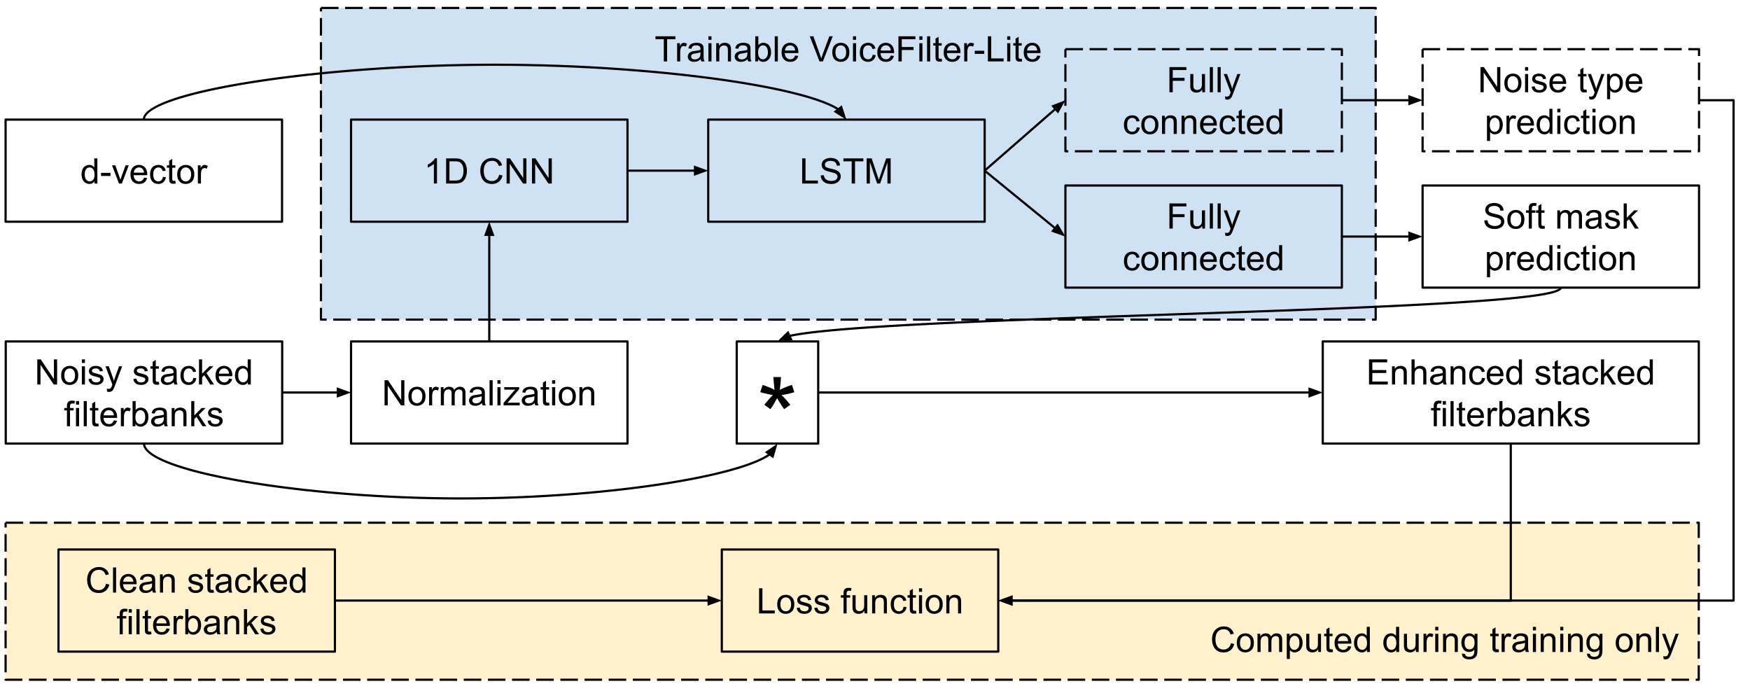
Model architecture
Assume we use stacked filterbanks as VoiceFilter-Lite I/O

Slide 18
What have changed since VoiceFilter
 | VoiceFilter | VoiceFilter-Lite
Input & Output | Audio waveform | ASR features (FFT magnitude, filterbank, etc.)
Inference | Full sequence offline inference | Online streaming inference (no time-freq CNN, no bi-LSTM)
STFT and iSTFT | Part of VoiceFilter model graph | STFT as part of ASR system; no iSTFT
Model format and size | TensorFlow graph; typically >100MB | Quantized to int8 TFLite model; typically <10MB

Slide 19
VoiceFilter-Lite vs joint training with ASR
Joint training with ASR
Concatenate d-vector with filterbanks for ASR training
Creates dependency between ASR and speaker recognition models
What if user did not enroll (d-vector not available)?
VoiceFilter-Lite
It’s a plug-and-play model
ASR can be retrained and replaced independently
Can be simply disabled by passing through the inputs
filterbanks
d-vector
Concat
ASR

Slide 20
Part 4:
The long fight with over-suppression

Slide 21
Why it’s a hard problem
Modern ASR models are already noise-robust
Multistyle training (MTR)
SpecAugment
Further masking the input of such a model is risky
Early experiments show that adding VoiceFilter-Lite model will:
Reduce WER on speech noise cases
Increase WER on clean cases and non-speech noise cases
Most errors in WER are deletion errors – over-suppression

Slide 22
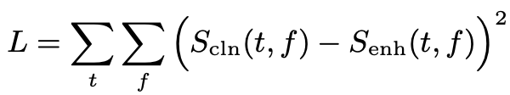
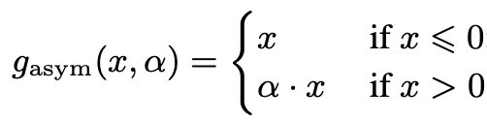
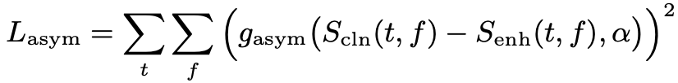
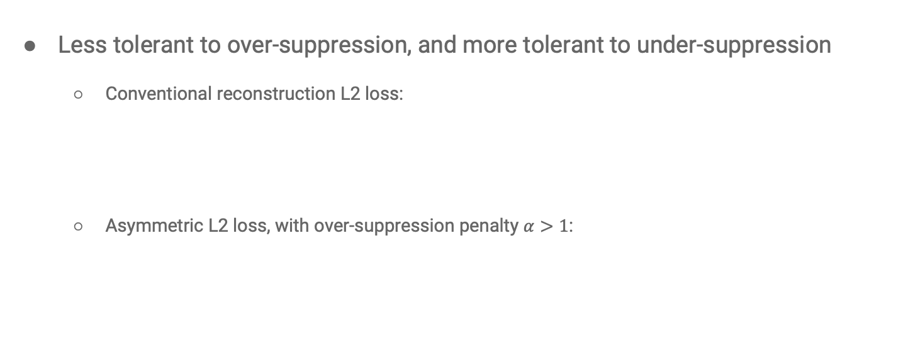
Asymmetric loss
Less tolerant to over-suppression, and more tolerant to under-suppression
Conventional reconstruction L2 loss:
Asymmetric L2 loss, with over-suppression penalty $α>1$:
clean
spectrogram
enhanced
spectrogram

Slide 23
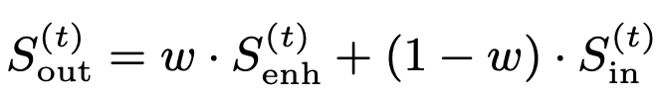
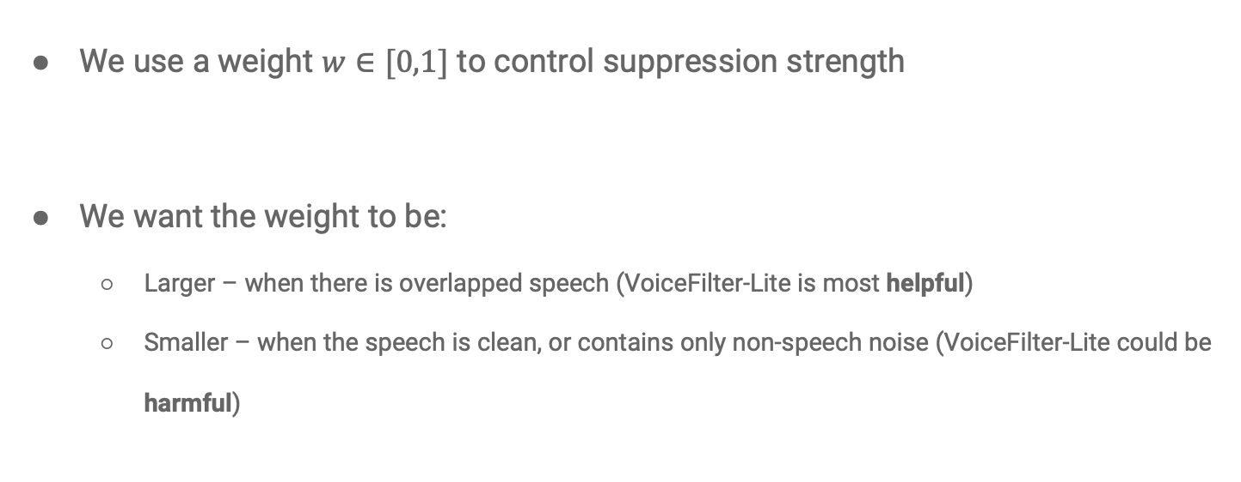
Adaptive suppression strength
We use a weight $w∈[0,1]$ to control suppression strength
We want the weight to be:
Larger – when there is overlapped speech (VoiceFilter-Lite is most helpful)
Smaller – when the speech is clean, or contains only non-speech noise (VoiceFilter-Lite could be harmful)

Slide 24
Adaptive suppression strength
We add a side output to the model, and a prediction loss to the total loss

Slide 25
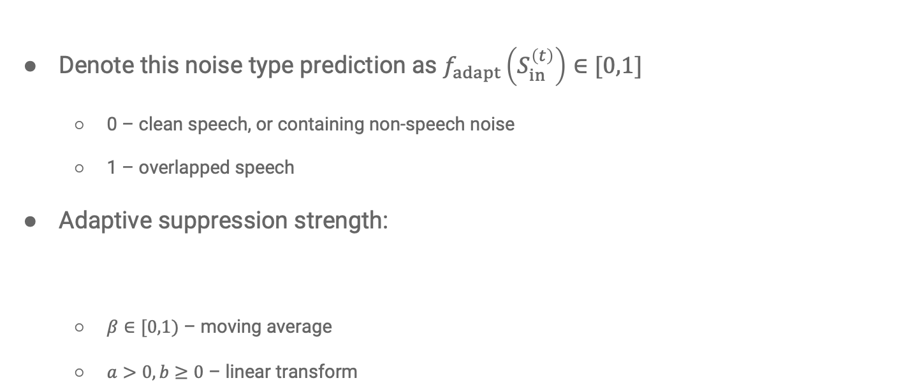
Adaptive suppression strength
Denote this noise type prediction as $f_{adapt}\left(S_{in}^{\left(t\right)}\right)∈[0,1]$
0 – clean speech, or containing non-speech noise
1 – overlapped speech
Adaptive suppression strength:
$β∈[0,1)$ – moving average
$a>0, b≥0$ – linear transform

Slide 26
Part 5:
Experiment setup

Slide 27
Metrics
Word Error Rate (WER) is all we need
Why not signal-to-noise ratio (SNR) or source-to-distortion ratio (SDR)?
There is no audio
The I/O of VoiceFilter-Lite are ASR features

Slide 28
Models
Speaker recognition (enrollment):
3 LSTM layers, each with 768 nodes and 256-dim projection
1 final feedforward layer with 256 nodes
VoiceFilter-Lite:
3 LSTM layers, each with 512 nodes
1 feedforward layer with sigmoid activation for mask prediction (dimension depends on I/O)
2 feedforward layers, each with 64 nodes for noise type prediction

Slide 29
Data generation for training and evaluation
(case 4)
(case 2)
Speech additive
Non-speech noise additive
SNR 1dB~10dB
SNR 1dB~10dB
(case 1)
Music
Sound effects
Cafe ambient noise
Car ambient noise
Quiet ambient noise
Interfering speech
Clean speech
Non-speech noise
Room simulator
SNR 1dB~10dB
Room simulator
SNR 1dB~10dB
Room configurations
Speech noise reverberant
Non-speech noise reverberant
(case 5)
(case 3)

Slide 30
Two experiment groups
Group 1: LibriSpeech
RNN-T streaming ASR model trained on LibriSpeech training set
VoiceFilter-Lite also trained on LibriSpeech
Evaluate on LibriSpeech testing set (“test-clean” and “test-other”)
Group 2: Realistic speech queries
RNN-T streaming ASR model trained on YouTube, anonymized voice search, etc.
VoiceFilter-Lite training and ASR evaluation: Vendor collected dataset of realistic speech queries
Much more challenging than Group 1:
More variations of prosody, sentiment, accent, and acoustic condition
Domain mismatch with ASR training set

Slide 31
Part 6:
Results and conclusions

Slide 32
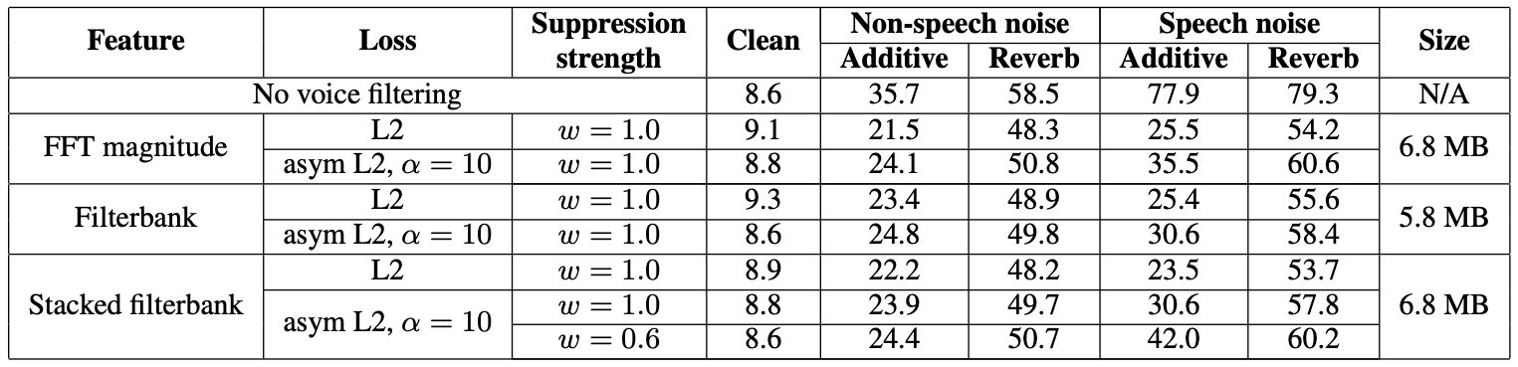
Results of Group 1 (LibriSpeech)
VoiceFilter-Lite consistently improves WER on both non-speech noise and speech noise cases

Slide 33
Results of Group 1 (LibriSpeech)
L2 loss: WER degrades on clean cases

Slide 34
Results of Group 1 (LibriSpeech)
Asymmetric L2 loss: Less degradation on clean; also less improvement on speech noise cases

Slide 35
Results of Group 1 (LibriSpeech)
Filterbank and stacked filterbank outperform FFT magnitude

Slide 36
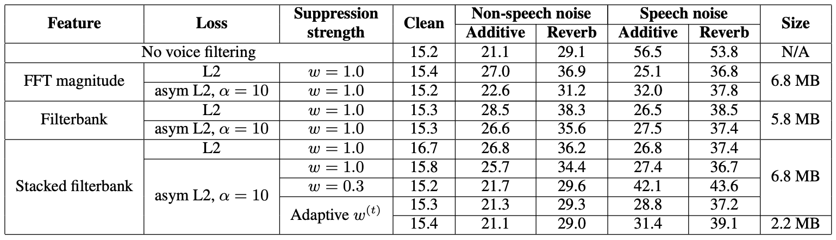
Results of Group 2 (Realistic speech queries)
L2 and asymmetric L2 loss: WER may degrade on both clean and non-speech noise cases

Slide 37
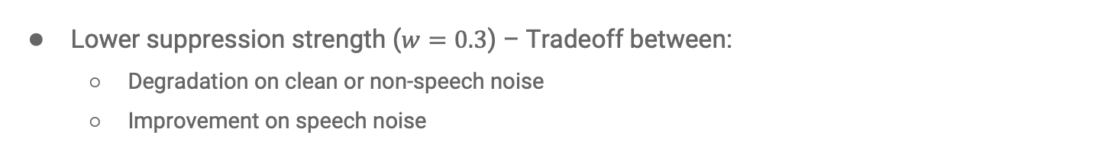
Results of Group 2 (Realistic speech queries)
Lower suppression strength ($w=0.3$) – Tradeoff between:
Degradation on clean or non-speech noise
Improvement on speech noise

Slide 38
Results of Group 2 (Realistic speech queries)
Adaptive suppression strength:
Minimal degradation on clean or non-speech noise
Still big improvement on speech noise
Smaller model works similarly well

Slide 39
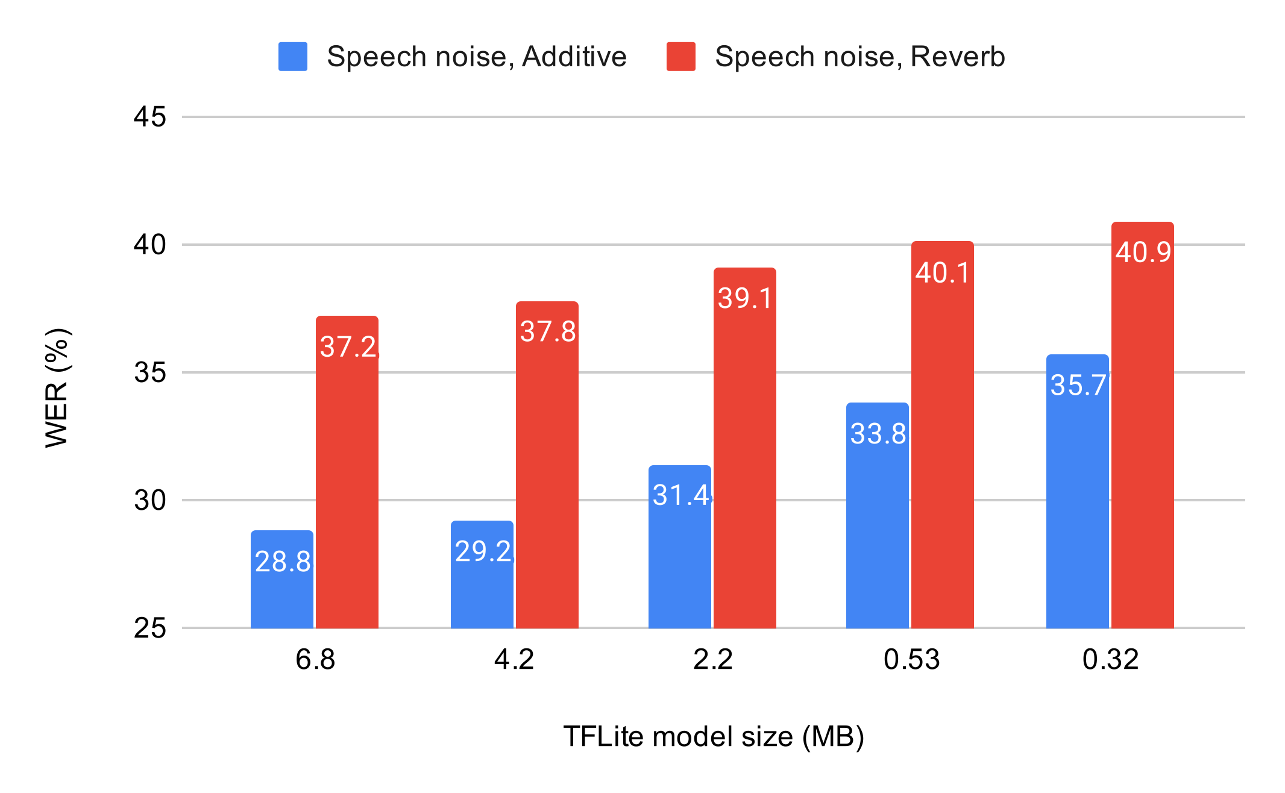
Results of Group 2 (Realistic speech queries)
Can the model size go further down?
No voice filtering baseline:
Speech noise, Additive: 56.5%
Speech noise, Reverb: 53.8%

Slide 40
Which frontend to use?
Filterbank and stacked filterbank outperform FFT magnitude
We prefer stacked filterbank over filterbank
More context information
Less runtime operations (usually subsample the frames after stacking)

Slide 41
Conclusions
VoiceFilter-Lite: Use your enrolled voice to improve ASR on overlapped speech
It’s tiny, fast, streaming, and part of on-device ASR
Two approaches to resolve over-suppression issues:
Asymmetric loss
Adaptive suppression strength
A model of 2.2 MB:
No WER degradation on clean and non-speech noise conditions
25.1% (44.4% rel.) WER improvement on overlapped speech

Slide 42
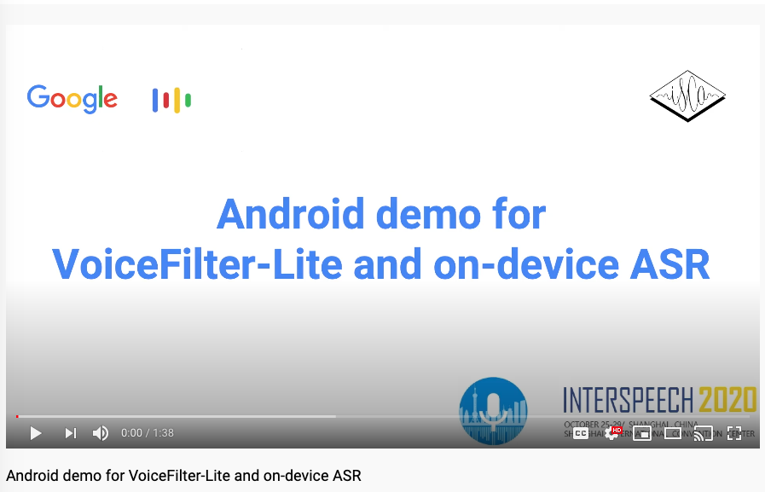
Demo

Slide 43
Acknowledgement
We’d like to thank Philip Chao, Sinan Akay, John Han, Stephen Wu, Yiteng Huang, Jaclyn Konzelmann and Nino Tasca for the support and helpful discussions

Slide 44
Questions?

